Slide 1


Unit 1: Lesson 3
Teenage film star

Slide 2
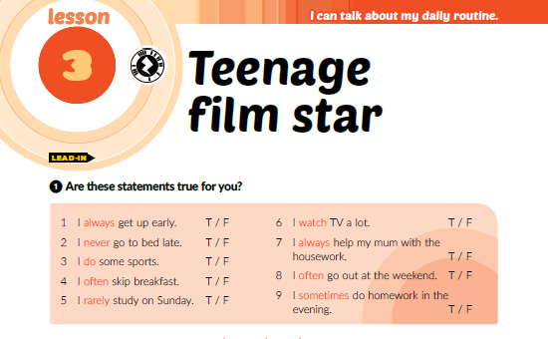

Slide 3



Slide 4
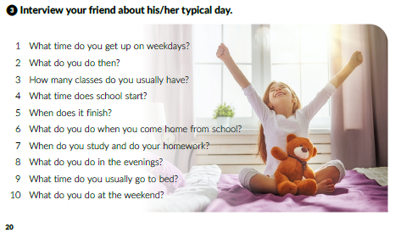
1 On weekdays I get up at _____ o’clock.
2.Then I _____.
3 I usually have ____ classes.
4 The school starts at _____ o’clock .
5 The school finishes at _____ .
6. When I come home from school,
I ____
7 I study and do my homework ______.
8 In the evenings I ______ .
9 I usually go to bed at about ____ o’clock
10 At the weekends I _______ .

Slide 5

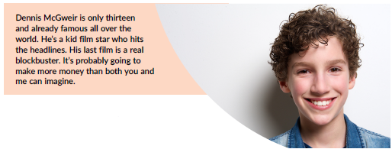

Slide 6
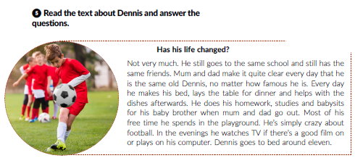

1 Yes, he does.
2 No, they don’t
3.He still goes to school.
4 He still has the same friends.

Slide 7
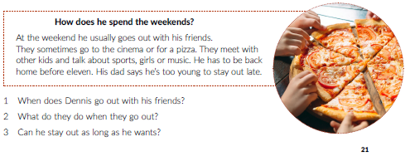
1 Dennis usually goes out with his friends at the weekends.
2 They sometimes go to the cinema or for a pizza.
They meet with other kids and talk about sports, girls or music.
3 He cannot stay as long as he wants. He has to be back home before eleven.

Slide 8
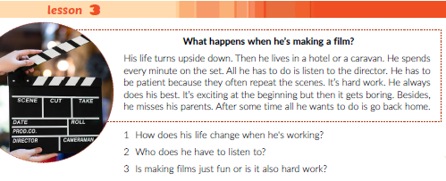
1 When he’s working, his life turns upside down.
He lives in a hotel or a caravan, and spends every minute on the set.
2 He has to listen to the director.
3 Making films is fun. It’s exciting at the beginning, but it gets boring.
So, it is also hard work.

Slide 9
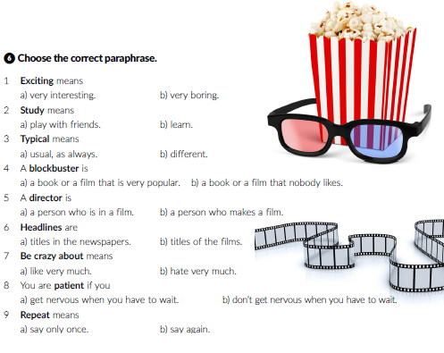

Slide 10
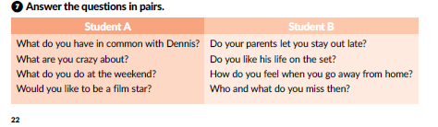

Slide 11
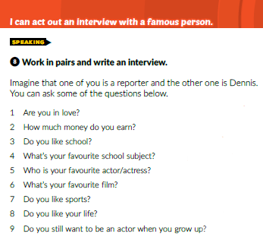


Slide 12


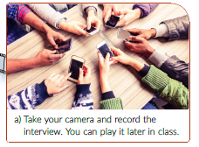
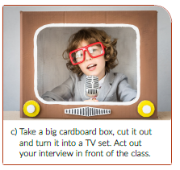
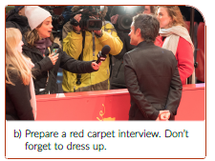

Slide 13
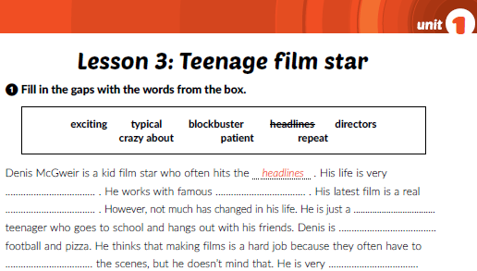
workbook p. 13
exciting
directors
blockbuster
typical
crazy about
repeat
patient

Slide 14
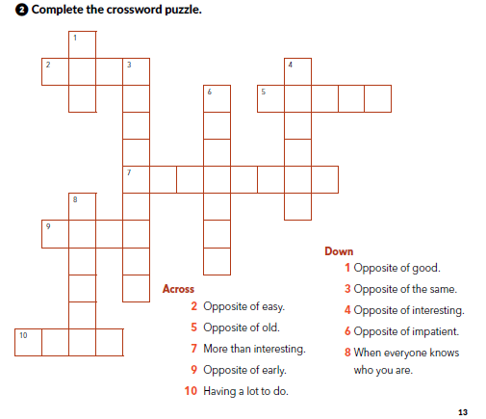
B
A
D
H R D
B
O
R
I
N
G
I
F
F
E
R
E
N
T
P
A
T
I
E
N
T
Y U N G
X C T I G
F
A
M
O
U
S
L T
B U Y

Slide 15
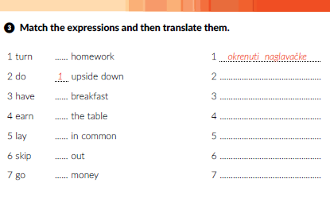
2
napraviti zadaću
6
imati nešto zajedničko
5
zarađivati novac
3
postaviti stol
7
preskočiti doručak
4
izlaziti van

Slide 16
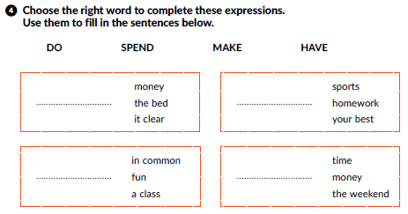
MAKE
DO
HAVE
SPEND

Slide 17
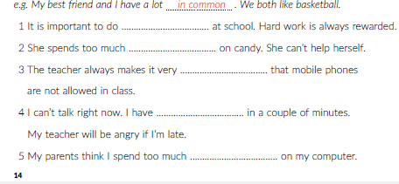
❹ Complete the sentences.
your best
money
clear
a class
time

Slide 18
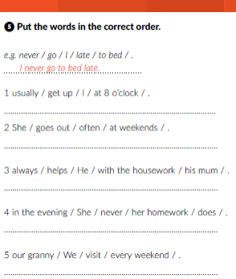

Workbook p. 15
I usually get up at 8 o’clock.
She often goes out at weekends.
He always helps his mum with the housework.
She never does her homework in the evening.
We visit out granny every weekend.

Slide 19
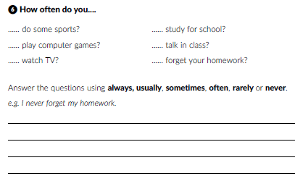
I _________ do sports
I ____________ play computer games
I ____________ watch TV.
I ____________ study for school.

Slide 20
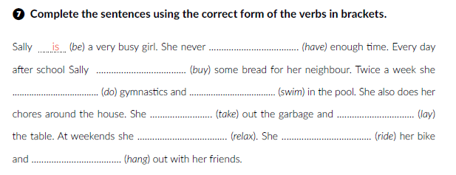
has
buys
does
swims
takes
lays
relaxes
rides
hangs

Slide 21
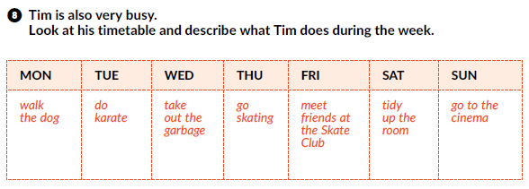
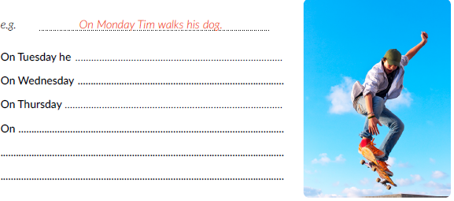
does karate.
takes out the garbage.
he goes skating.
Fridays he meets friends at the Skate Club.
On Saturdays he tidies up the room.
On Sundays he goes to the cinema.

Slide 22

PLAY AND LEARN!
Lesson 3 Teenage film star | Way to go 3 (e-sfera.hr)

